Slide 1
분석도전

Slide 2
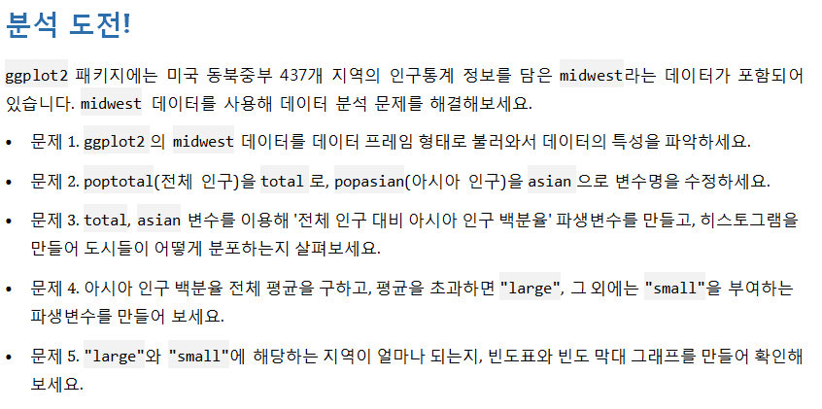

Slide 3
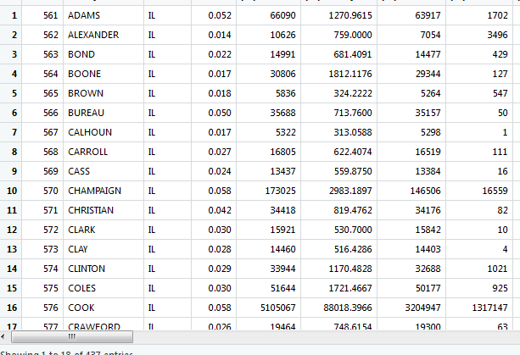
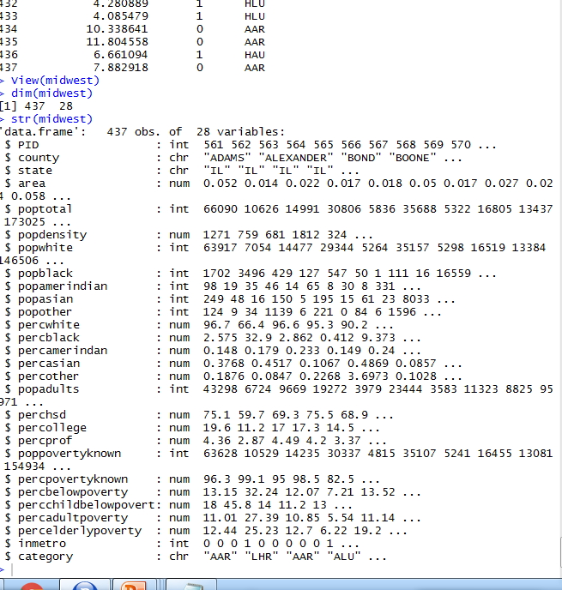
midwest<-as.data.frame(ggplot2::midwest)
head(midwest)
tail(midwest)
View(midwest)
dim(midwest)
str(midwest)
Summary(midwest)

Slide 4
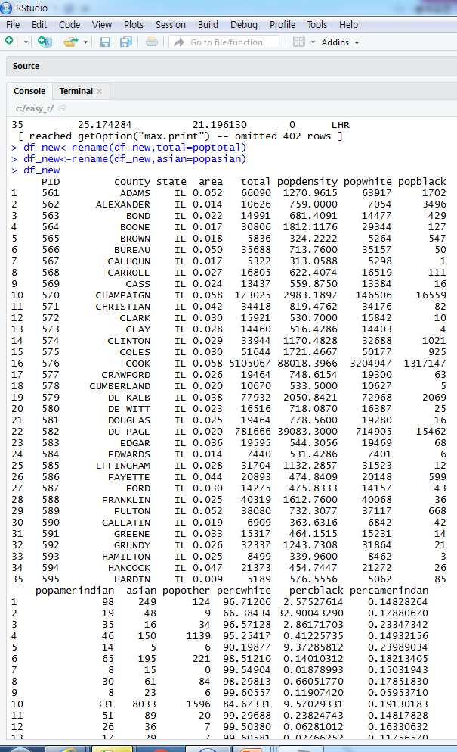
2. 변수명 바꾸기
Library(dplyr)
df_new<-midwest
df_new
df_new<-rename(df_new,total=poptotal)
df_new<-rename(df_new,asian=popasian)
df_new

Slide 5
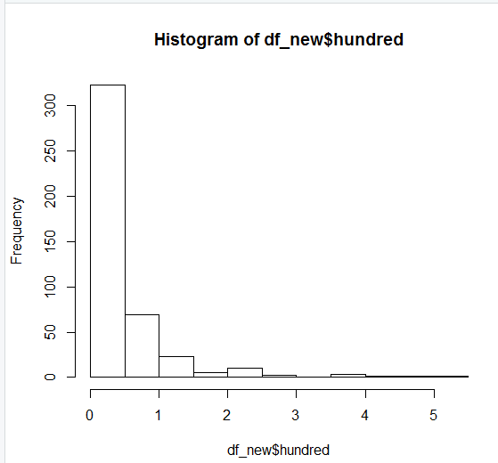
3.히스토그램
df_new$hundred<-((df_new$asian/df_new$total)*100)
hist(df_new$hundred)

Slide 6
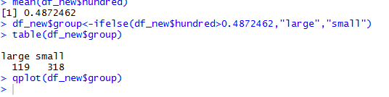
4번
mean(df_new$hundred)
library(ggplot2)
df_new$group<-ifelse(df_new$hundred>0.4872462,"large","small")

Slide 7
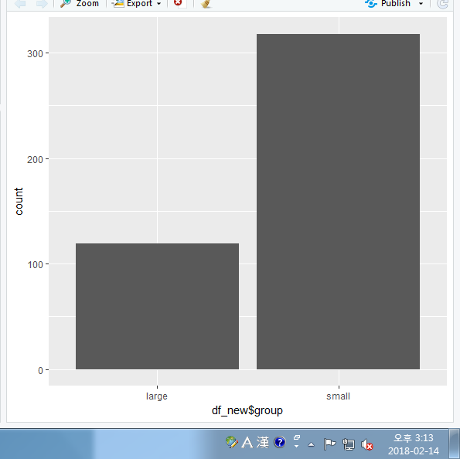
5번
table(df_new$group)
qplot(df_new$group)

